Slide 1
Web Application Security Using Paros
Team Members-
2010030508-S.Padmashree
2010030517-M.Manideepa
2010030512-L.Keerthana
Guided by-
Dr. Gayathri Edamadaka

Slide 2
TABLE OF CONTENTS
ABSTRACT
INTRODUCTION
LITERATURE SURVEY
IMPLEMENTATION
RESULT
SOFTWARE & HARDWARE TOOLS
GITHUB SETUP
CONCLUSION

Slide 3
ABSTRACT
Web application security (also known as Web AppSec) is the idea of building websites to function as expected, even when they are under attack. The concept involves a collection of security controls engineered into a Web application to protect its assets from potentially malicious agents. Web applications, like all software, inevitably contain defects. Some of these defects constitute actual vulnerabilities that can be exploited, introducing risks to organizations. Web application security defends against such defects. It involves leveraging secure development practices and implementing security measures throughout the software development life cycle (SDLC), ensuring that design-level flaws and implementation-level bugs are addressed.We are using paros web application to design this project

Slide 4
INTRODUCTION
A Web application (Web app) is an application program that is stored on a remote server and delivered over the Internet through a browser interface.
How do web application work?
Web applications can be designed for a wide variety of uses and can be used by anyone; from an organization to an individual for numerous reasons. Web applications do not need to be downloaded since they are accessed through a network. Users can access a Web application through a web browser such as Google Chrome, Mozilla Firefox or Safari.
For a web app to operate, it needs a Web server, application server, and a database. Web servers manage the requests that come from a client, while the application server completes the requested task. A database can be used to store any needed information.

Slide 5
LITERATURE SURVEY
S:NO | TITTLE AND LINK | AUTHUR | YEAR OF PUBLISHING | OBSERVATION
1. | Test SQL injection vulnerabilities in web applications based on structure matching LINK:-https://scholar.google.com/scholar?hl=en&as_sdt=0%2C5&q=web+application+using+paros&oq=#d=gs_qabs&t=1660207193644&u=%23p%3D3-YbEg8H-E8J | Haiyan Wu, Guozhu Gao | 2019 | SQL injection, known as a popular attack against web applications, has become a serious security risk. However, traditional penetration test methods are insufficient to test SQL injection vulnerabilities (SQLIVs) in web applications. This paper presents a new test method called SMART, which automatically tests SQLIVs in web applications.
2. | Assessment of web scanner tools LINK:-https://scholar.google.com/scholar?hl=en&as_sdt=0%2C5&q=web+application+using+paros&oq=#d=gs_qabs&t=1660207224978&u=%23p%3Dt8U_WZumjqwJ | Rawaa Mohammed | 2021 | Nowadays the security of web applications becomes a serious problem because of the impact of its vulnerability, so a previous consideration should be taken to diminish its harmful effect. One of the most important tools used to test the security of the web is web security scanner which is a tool that can be used by the penetration tester to give clear indication of the weakness by detecting the vulnerabilities of web pages like SQL injection, XSS attack.
3. | A case study on web application security testing with tools and manual testing | LaShanda Dukes, Xiaohong Yuan, Francis Akowuah | 2022 | Web application security has become a big issue because of common vulnerabilities found in web applications. This paper illustrates a case study on conducting security testing on an example application, Tunestore. The example application was tested using a number of tools such as Paros . Manual testing was also con ducted. The testing results of different tools and manual testing are compared and discussed. Our case study shows manual testing is very important since some vulnerability types can only be found through manual testing and tester's obs ervations, and it is important to utilize a variety of tools as well as conduct careful manual testing in order to find the most number of vulnerabilities in a web application. Based on this case study, hands-on labs can be developed for teaching web security, software security testing, and other topics.

Slide 6
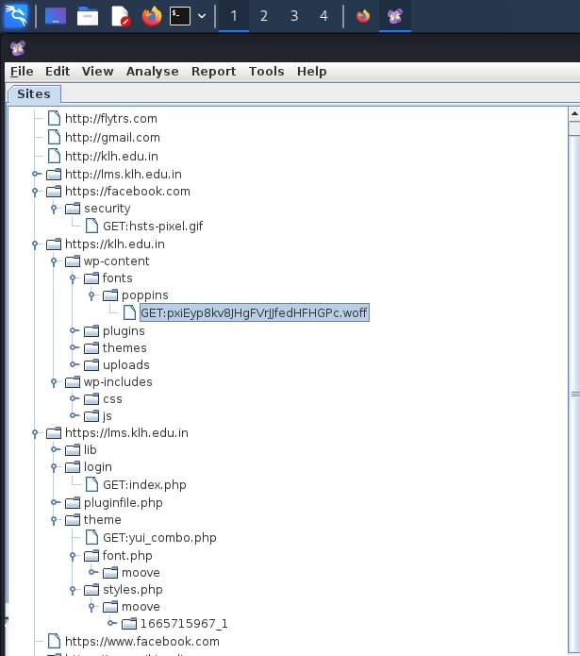
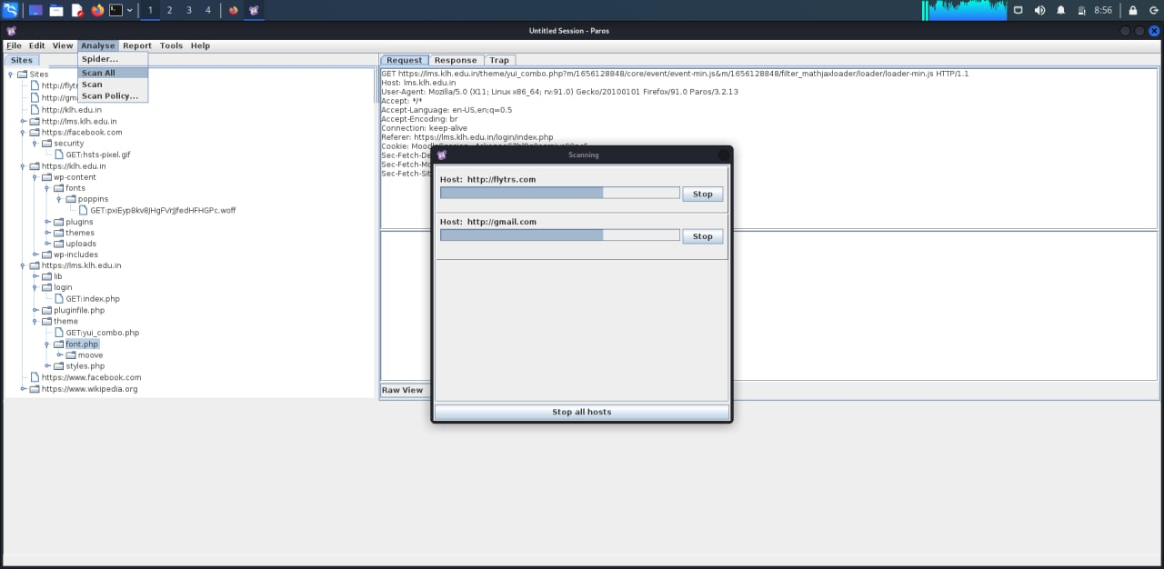
IMPLEMENTATION

Slide 7
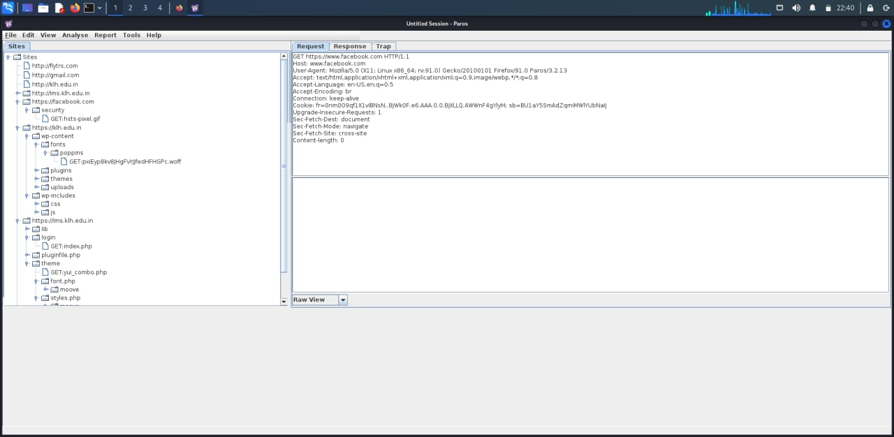
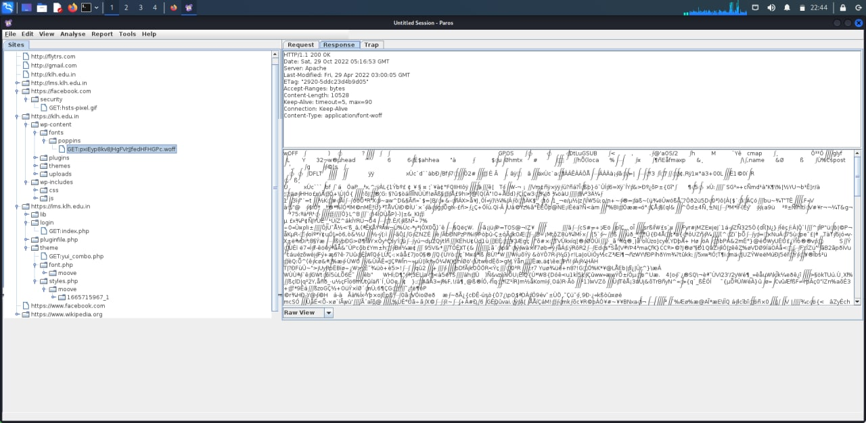
RESULT

Slide 8
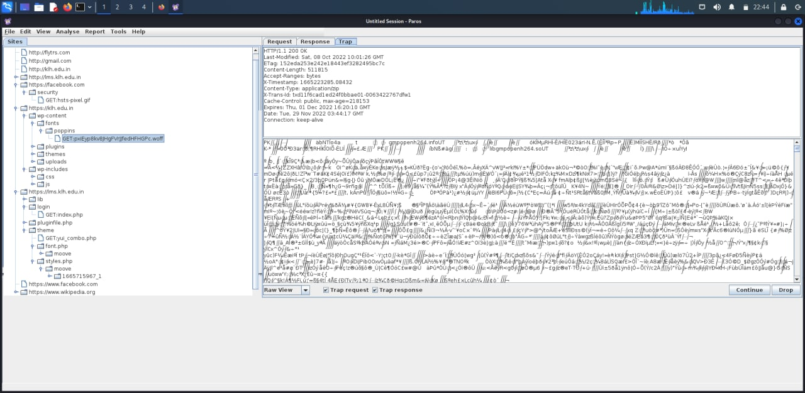

Slide 9
SOFTWARE & HARDWARE TOOLS
SOFTWARE REQUIREMENTS:
The major software requirements of the project are as follows:
• Operating system: Windows 10 or later.
• Tools: Paros
2. HARDWARE REQUIREMENTS:
• The hardware requirements that map towards the software are as follows:
• RAM:512MB
• Processor: computer system with Intel Core 2Duo E7300

Slide 10
About Paros
Paros runs as a GUI JAVA application and supports spidering, HTTP message editing, proxy-chaining, and intelligent scanning for SQL and XSS vulnerabilities. However, it has not been updated since August 14, 2013 and, as a result, may be prone to many false positives or may even miss some vulnerabilities.

Slide 11
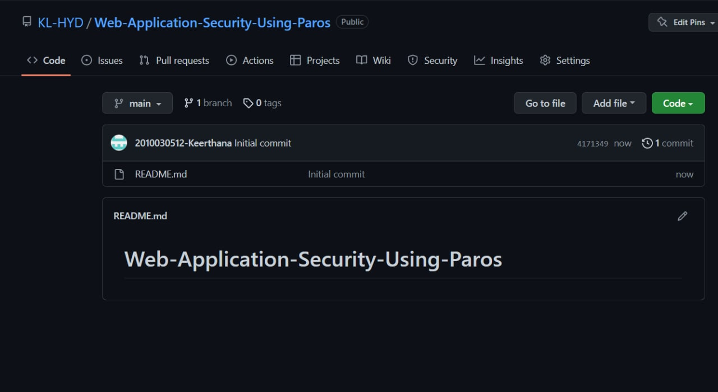
GITHUB SETUP

Slide 12
CONCLUSION
A web application should be secured so that every single person's data and a individual or a organization can use the particular application safely. So we are using paros proxy lightweight web application tool to test the web application security and also ensure how it work and also to know more about security vulnerabilities

